Slide 1
Unit 1: Scientific Method

Slide 2
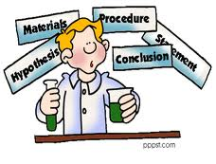
What is the scientific method?
A scientific way to solve a problem.
All scientists use this!

Slide 3
PHEOC
Problem (research) Question- What are we researching?
Hypothesis- What do we think will happen?
Experiment– What did you do?
Observations- What did you see?
Conclusion- Why did this happen?

Slide 4
Problem (research) Question
What is wrong, or what you are interested in understanding
Includes independent and dependent variable

Slide 5
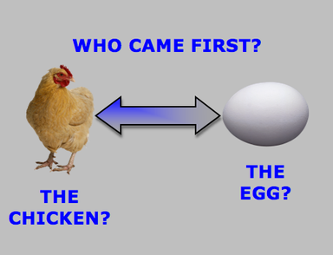
Hypothesis
Explanation for a question
Educated guess
If…then….because statement

Slide 6
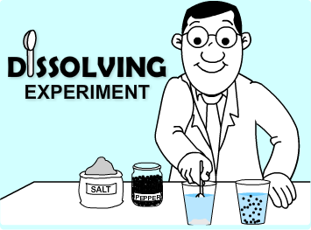
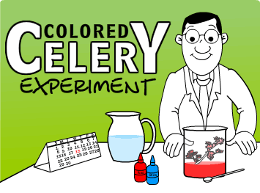
Experiment
The physical steps you take to answer the problem
Numbered list of what was done

Slide 7
Observation
Data within a data table
Numbers (measurements)
Descriptions of experiment
Example:
 | Height of the seed growth of each seed in each petri dish (+/- 0.01 cm)
Petri dish #1 (5.0 mL of water) | 0.00cm, 0.00cm, 0.00cm, 0.00cm, 0.00cm
Petri dish #2 (10.0 mL of water) | 1.88cm, 1.20cm, 0.40cm, 0cm, 1.5cm
Petri dish #3 (15.0 mL of water) | 2.20cm, 0cm, 1.40cm, 2.00cm, 2.30cm
Petri dish #4 (20.0 mL of water) | 2.50cm, 2.50cm, 2.80cm, 2.00cm, 2.70cm
Petri dish #5 (25.0 mL of water) | 2.80cm, 3.10cm, 2.80cm, 2.10cm, 2.20cm
Data table: The growth (cm) of 5 seeds in 5 different amounts of water (5.0, 10.0, 15.0, 20.0 and 25.0 mL of water)

Slide 8
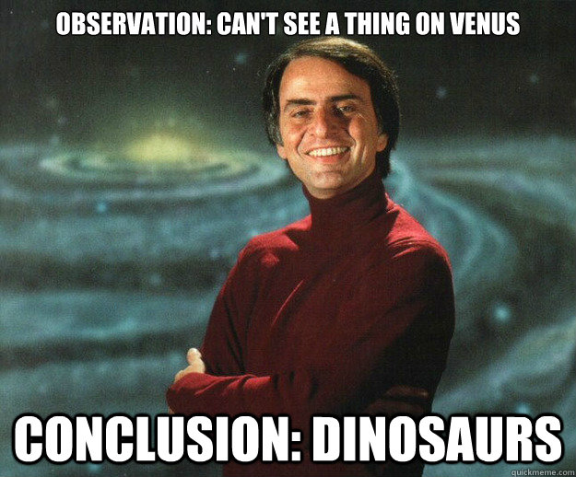
Conclusion
Conclusion:
If your hypothesis is correct or not and why
Talk about your data and how you can improve the experiment

Slide 9
How Do We Write a Hypothesis?
Three Requirements
If…,then… because statement
Can be tested
Be Specific!
Include units
Example: cm

Slide 10
How to write a Hypothesis Examples:
Problem Question: Would eating chocolate cause pimples?
Incorrect: Chocolate may cause pimples
Correct: If chocolate causes pimples, then people who eat lots of chocolate will get pimples, because chocolate leaves toxins in the intestinal tract.

Slide 11
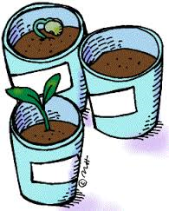
How to write a Hypothesis Examples:
2. Problem Question: Will salt in soil affect plant growth?
Incorrect : Salt in soil may affect plant growth.
Correct: If salt affects plant growth, then plants with exposure to excessive amounts of salt will not grow, because the salt sucks the water out of the soil.

Slide 12
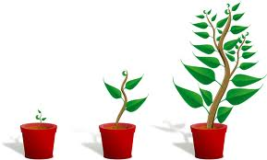
How to write a Hypothesis Examples:
Problem Question: Will plant growth be affected by the color of light?
Incorrect: Plant growth may be affected by the color of light
Correct: If light color affects plant growth, then plants will grow the tallest in white light, because the light is a mixture of all colors.

Slide 13
How to write a Hypothesis Examples:
Problem Question: Does temperature affect Bacteria growth?
Correct: If temperature affects bacterial growth, then bacteria will not grow if the temperature gets to 0 C because the temperature is too cold for bacteria to reproduce.
Problem Question: Will Ultra violet light cause skin cancer?
Correct: If skin cancer is caused by ultraviolet light , then people with a high exposure to UV light will have a higher frequency of skin cancer, because ultra violet light will mutate skin cells.

Slide 14
How to write a Hypothesis Examples:
Problem Question: Does temperature cause leaves to change color?
Correct: If leaf color change is related to temperature , then exposing plants to low temperatures will result in changes in leaf color, because the low temperatures cause the chlorophyll to break down.

Slide 15
What is the difference between hypothesis, theory & law?
Hypothesis - “an educated guess”; a tentative explanation of phenomena.
Theory - a widely accepted explanation of natural phenomena; has stood up to testing.
Example: Evolution
Law - a statement of what always occurs under certain conditions.
Example: Gravity

Slide 16
Variables
Control = The condition(s) that is kept the same
Independent Variable = This is the variable you changed; what are you testing.
You change it!
You can only have one independent variable.
Must include units.
X-axis

Slide 17
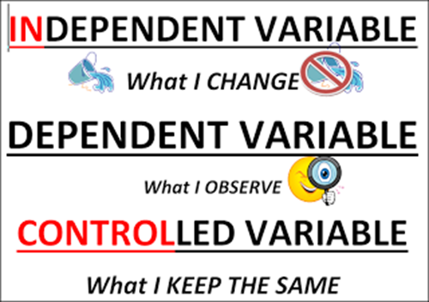
Variables continued…
Dependent Variable = The variable you are measuring.
You measure it!
You can only have one dependent variable.
Must include units.
Y-axis

Slide 18
Kinds of Data
Quantitative = numerical data
There were 7 blue birds after 3 months.
The plant grew 5.6 cm over 9 days.
Qualitative = observational data (no numbers)
A Red and Yellow bird couple gave birth to all blue birds.
The solution turned
turned from colorless
to a blue color

Slide 19
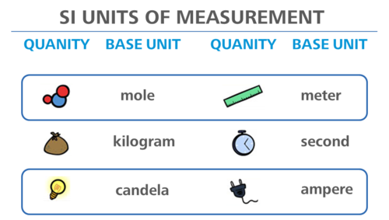
International System of Measurements (SI)
Base Units
Length = meter (m)
Mass = gram (g)
Volume = liter (L)
Time = second (s)

Slide 20
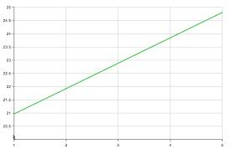
Observations: Graphing
Always need a title (Y axis vs X-axis)
Logical scale on each axis that is labeled.
Axes need a label with measurement!
GRAPH TITLE: Y-axis vs. X-axis
Y-axis (Dependent Variable)
X-axis (Independent Variable)

Slide 21
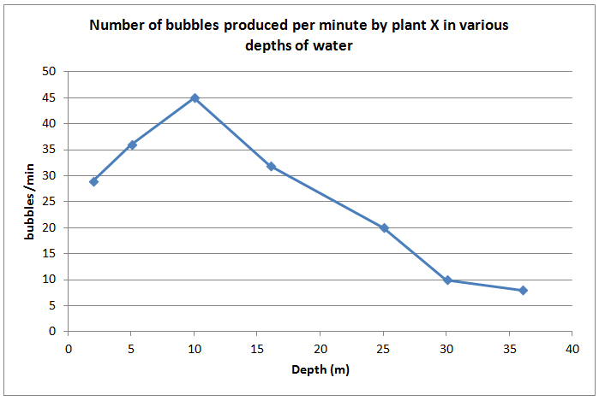
Line Graph
Used to show relationships between two variables
Used when data is continuous.

Slide 22
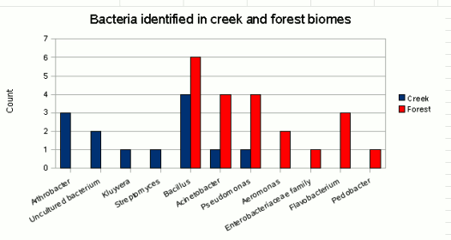
Bar Graph
Used to compare data about different organisms or things.
Can be used to show data that is not continuous

Slide 23
Experimental Procedure
Do not write in the first person with “I”, “we” or any other personal pronouns!
Number each step in order
Include all steps, including how to get and record the data
Is this a good procedure? Why or why not?

Slide 24
Conclusion
Restate the original research question and hypothesis.
To write your conclusion, give specific examples from your results (data) to fully answer the research question. Explain how the results support or negate your hypothesis.
Your conclusion should be fully supported by your actual data.

Slide 25
The Scientific Method?

