Slide 1
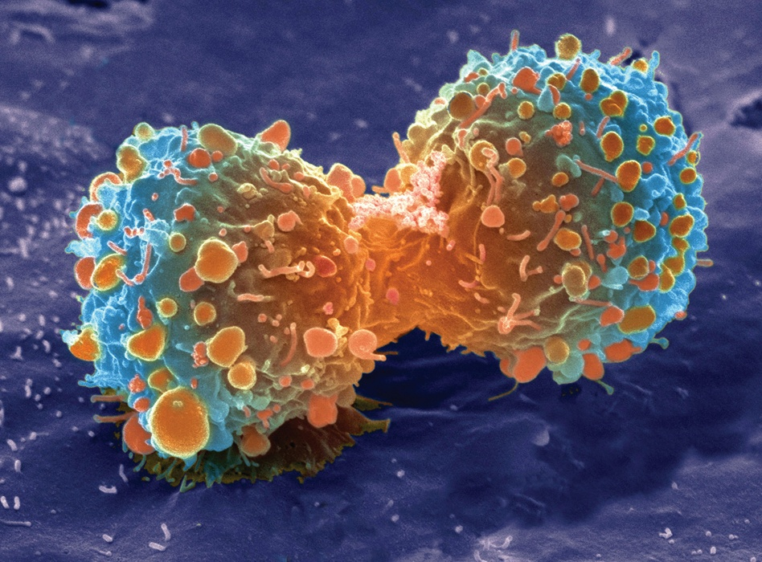
Unit 4a
Cell Division
Mitosis

Slide 2
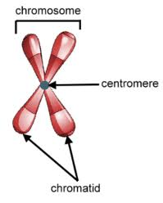
Structure of DNA
Centromere – structure that holds two identical DNA molecules together
Chromatid – each individual molecule of DNA
Sister chromatids – identical molecules of DNA
Chromosomes – contains DNA (genetic material) that are passed from one generation to another (23 pairs)

Slide 3
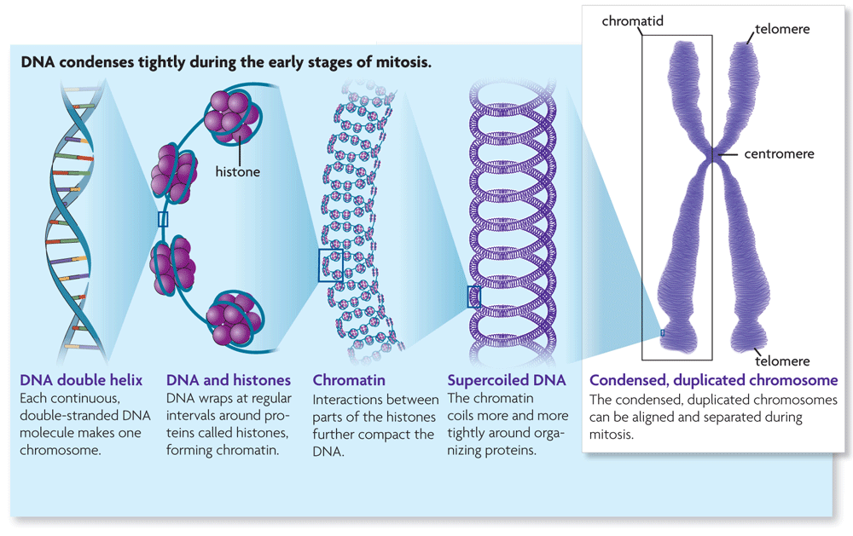
DNA Packing (Supercoiling) & Unpacking
DNA is a very long molecule which make proteins (we can’t see it)
In order to make proteins the code (letters) needs to be visible
The DNA begins to supercoil by wrapping around proteins and folding itself. This is called Chromatin. (we can see it)
When Chromatin are wrapped on itself it turns into an “X” shape known as a Chromosome.

Slide 4
Why does a cell need to divide?
Growth - creating more cells of an organism
Embryonic development – creating cells in order for a embryo to develop
Tissue repair – create new cells because the existing cells are damaged
Asexual reproduction – creating new identical cells (example – bacteria in binary fission )

Slide 5
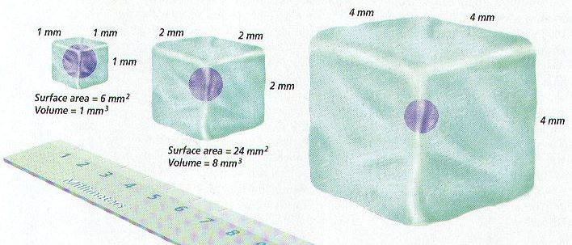
Why does a cell need to divide?
Ratio of surface area to volume limits the size of a cell
The greater the volume the smaller the ratio of surface area to volume. This ratio limits how large cells can be (ratio begins at 6 then to 3 then to 1.5 then to 1)
As cells grow, the amount of surface area becomes too small to allow materials to enter & leave the cell
Smaller cells are more efficient at exchanging materials (diffusion is fast & efficient over short distances)

Slide 6
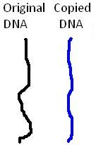
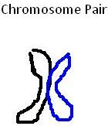
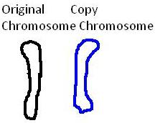
What are Chromosomes?
Human cells have 46 Chromosomes
Humans get 23 from the mother and 23 from the father.
The DNA is copied before it is wrapped into a chromosome.
Before cell divides each DNA supercoils into a chromosome
One side of the chromosome is the original chromosome
The other side of the chromosome is the copy of the original chromosome.
Centromere

Slide 7
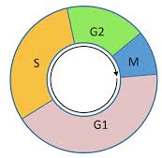
The Cell Cycle = Interphase & Mitosis
Interphase – before mitosis (longest phase in the cell cycle)
G1 phase
cell growth
production of new organelles
S phase = Double the DNA
DNA replication (duplicate)
G2 phase
cell prepares to divide
finishes growing
DNA begins to condense (supercoiling)

Slide 8
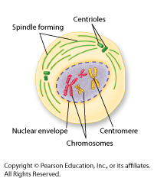
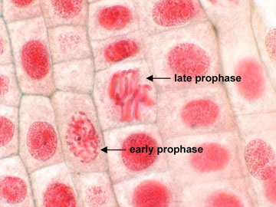
The M (Mitosis) Phase
Prophase
Chromosomes shorten, thicken and become visible
Nucleus and other organelles break down and disappear
Organelles called Centrioles begin to make spindle fibers

Slide 9
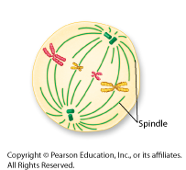
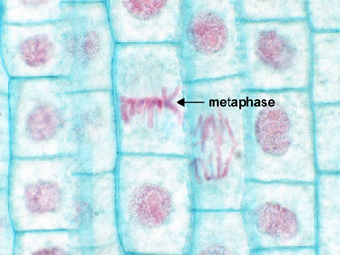
The M (Mitosis) Phase
Metaphase
spindle fibers become present and attach to centromeres of chromosome pair.
chromosomes line at center of cell (metaphase plate = equator)

Slide 10
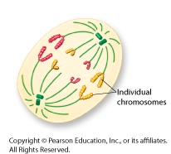
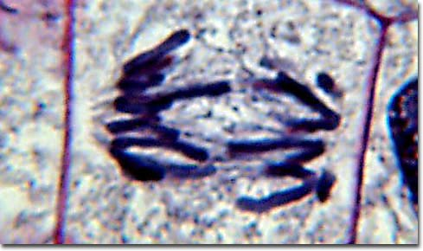
The M (Mitosis) Phase
Anaphase
The Chromatids are pulled apart towards polar ends of the cell.

Slide 11
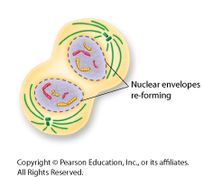
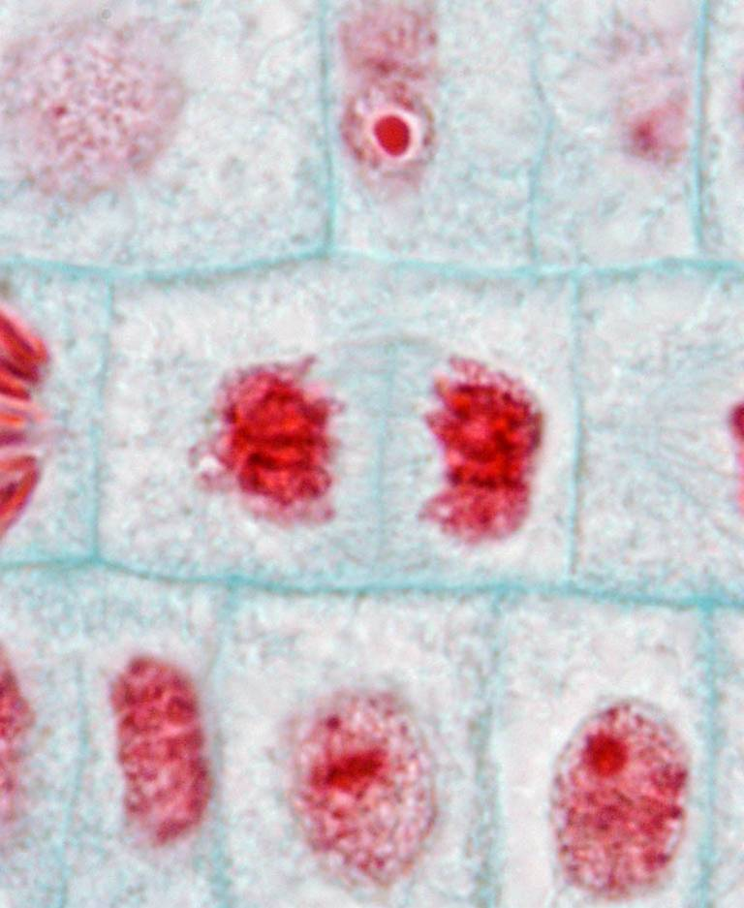
The M (Mitosis) Phase
Telophase
New nuclei form around each set of chromosomes
two new cells start to take shape
chromosomes begin to make proteins

Slide 12
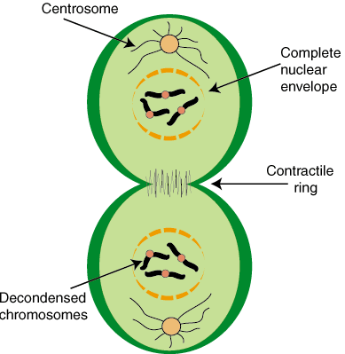
The M (Mitosis) Phase
Cytokinesis
In Animal cells
Animal cells undergo cytokinesis by pinching off along their equator
This works because their membrane is flexible.

Slide 13
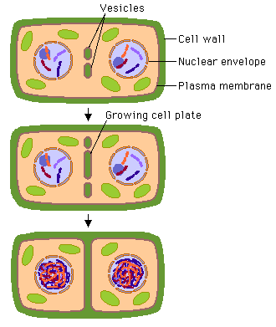
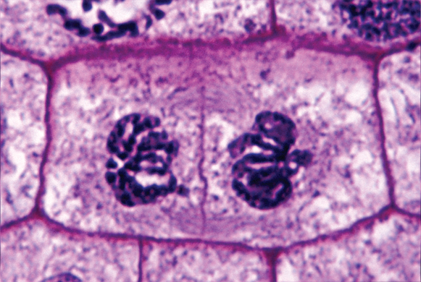
The M (Mitosis) Phase
Cytokinesis
In Plant cells
Plants have a cell wall which makes things more challenging
Plants send vesicles filled will cell wall material to their equator where they fuse together
This fusion creates cell plates that fuse with the cell wall separating the two cells.

Slide 14
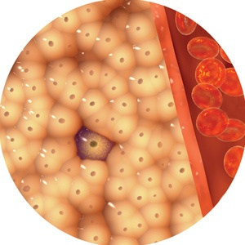
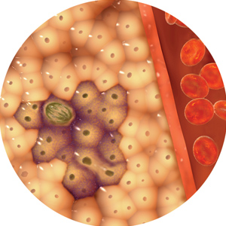
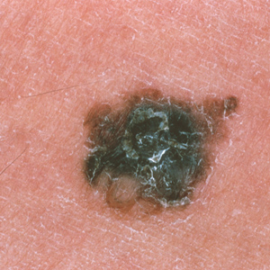
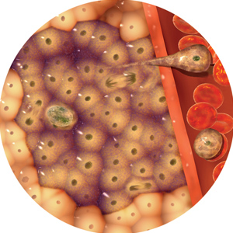
When Mitosis does not stop
Cancer occurs
Results in tumors forming throughout the body.
A tumor is a bunch of cells in one area of the body that keep dividing.
These cells can then move on to other parts of the body causing tumors to develop in other regions.
Cancer kills by causing your organs to malfunction.

Slide 15
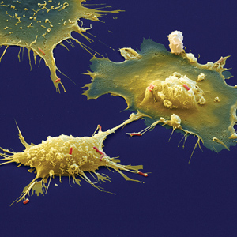
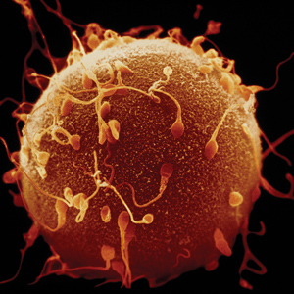
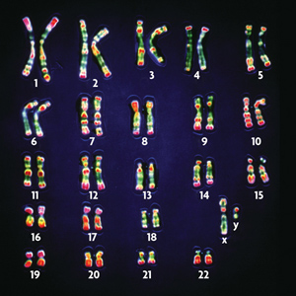
Body cells versus Sex cells
Somatic cells are body cells.
Make up most of your body cells.
These are diploid (2n)
Have two sets of chromosomes.
1 set from father & 1 set from mother
Gametes = sex cells(sperm/egg cells)
These are haploid (n)
Have only one set of chromosomes
Types of Chromosomes
Autosomes – contain genes not associated with sex
Sex chromosomes – directly control sexual traits.

Slide 16
Unit 4b
Cell Division
Meiosis I and II

Slide 17
Meiosis- The creation of sex cells
Interphase (G1, S, G2)
All your cells start off as diploid cells (2n): cell with two of each kind of chromosome (In humans = 46 [23 from each parent])
G1 – Cell grows; DNA is long and stringy and is not visible. (so the DNA can be copied)
S – DNA gets replicated (copied).
G2 – Cell continues growing and prepares to divide.

Slide 18
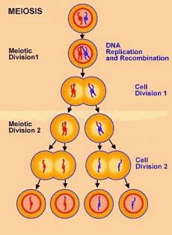

Slide 19
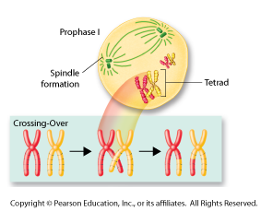
Meiosis I
Prophase I
The chromatin wind-up, creating chromosomes which can now be seen.
Centrioles create Spindle Fibers
Nuclear envelope disappears
Each chromosome pair then actively seeks out its homologous chromosome pair.
Homologous pairs are the same size and shape
This is called a tetrad (four chromatids)
Crossing Over will now happen.
where two non-sister chromatids exchange genetic material.

Slide 20
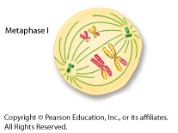
Meiosis I
Metaphase I
The spindle fibers attach to the centromere on each chromosome pair.
Homologous chromosomes are lined up on the metaphase plate (equator) by the spindle fibers in random order
2 rows of 23 chromosome pairs = 46 pairs total

Slide 21
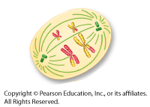
Meiosis I
Anaphase I
The tetrad gets pulled apart = homologous chromosomes separate.
CHROMATIDS DO NOT GET PULLED APART YET!
Each homologous chromosome moves to opposite poles.

Slide 22
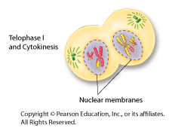
Meiosis I
Telophase I / Cytokenesis
Individual nuclear envelopes begin to surround the separate chromosome pairs
Cytokenesis separates the one cell in two.

Slide 23
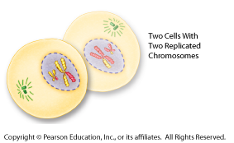
END OF MEIOSIS I
Two cells are created each with 23 chromosome pairs

Slide 24
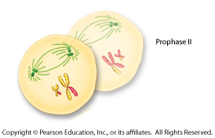
Meiosis II
Prophase II
Each dyad (2 Chromatids = 1 Chromosome pair) are connected by a centromere.
Nuclear envelope disappears
The centrioles create spindle fibers again.

Slide 25
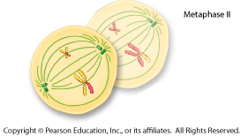
Meiosis II
Metaphase II
The spindle fibers attach to the centromere on each dyad (1 Chromosome pair = 2 Chromatids).
The dyads are lined up on the metaphase plate (equator) by the spindle fibers.
1 row of 23 chromosome pairs in each cell.

Slide 26
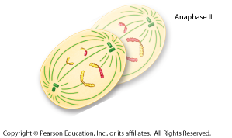
Meiosis II
Anaphase II
The individual sister chromatids from each dyad get pulled apart by the spindle fibers
Each sister chromatid ends up on opposite poles of the cell

Slide 27
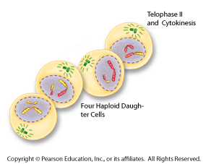
Meiosis II
Telophase II / Cytokenesis
The shape of the cell changes, beginning to form two cells.
New nuclei form around each set of chromosomes
The cytoplasm of both cells divides once again.
Four gametes (sex cells) are now created

Slide 28
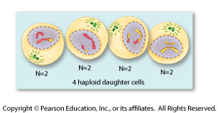
END OF MEIOSIS II
Four unique haploid cells are created, each with a half set of chromosomes compared to the original (Original Parent cell had 46, each daughter cell has only 23 chromosomes).
Haploid (n): cell with only 1 of each kind of chromosome (in humans = 23 chromosomes)

Slide 29
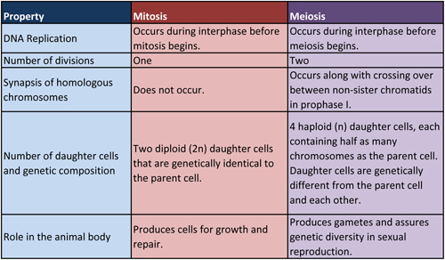
Mitosis vs Meiosis

Slide 30
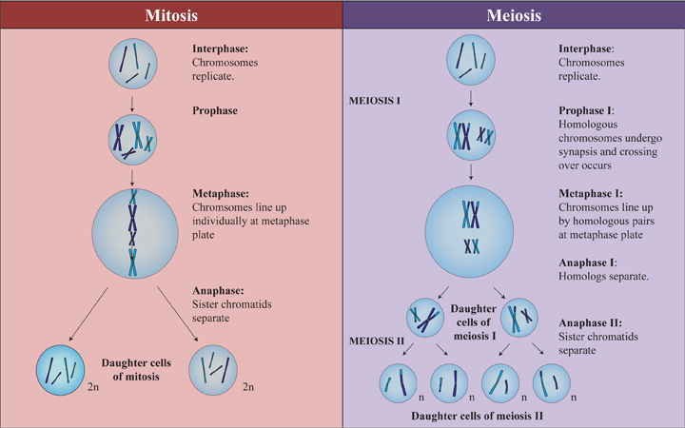
Mitosis vs Meiosis

