Slide 1
Unit 6
Heredity

Slide 2
Genetics
Genetics
The branch of biology that studies heredity
Heredity
The passing on of characteristics from parents to offspring through GAMETES (sex cells created in meiosis)
Traits
Characteristics that are inherited from the chromosomes you receive from each parent. (Review Meiosis)

Slide 3
Meiosis & Genetic Variety
Meiosis will result in the production of sex cells (gametes) which show an increase in genetic variety because of:
Crossing over during prophase I
Crossing over is when non-sister chromatids exchange genetic material
Random orientation of chromosomes during metaphase I
Random orientation is when the homologous chromosomes line up on the metaphase plate in a random order

Slide 4
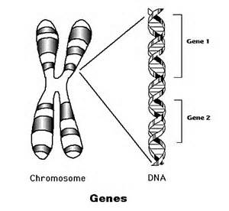
Genes in DNA
Gene
The heritable factor that codes for a polypeptide chain or for an RNA chain that has a function in the organism
Genome
The whole genetic information of an organism

Slide 5
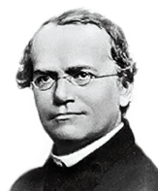
Mendel Genetics
Gregor Mendel
19th century Austrian Christian Monk
His research is the basis for our modern day notion of heredity.
Worked with pea plants to see how different traits were passed from generation to generation.

Slide 6
Mendel’s Monohybrid Crosses
Monohybrid Cross = 1 trait that differs in parents
Mendel created hybrids of pea plants from pure breeds
A Pure breed is an organism with no genetic variety
Mendel used pea plant height to determine how traits were passed on
He crossed One pure breed tall parent and One pure breed short parent
Each offspring had a combination of traits from each parents.

Slide 7
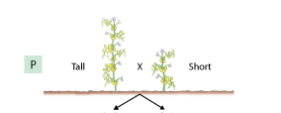
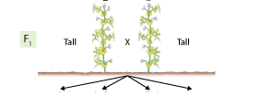
Mendel’s Results
P1 (parents) short pea plant X tall pea plant
F1(generation 1 = all tall)
F2 (generation 2 = 3 tall: 1 short)

Slide 8
Mendel’s Law of Independent Assortment
The Law of Independent Assortment states that every individual has 2 alleles for each gene (trait)
During Meiosis, the chromosomes which carry the alleles for a trait will be randomly distributed to the newly produced gametes.
This means that every gamete produced will be genetically unique from the other gametes.

Slide 9
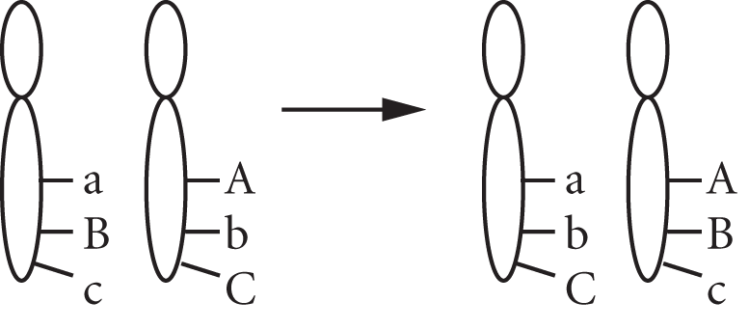
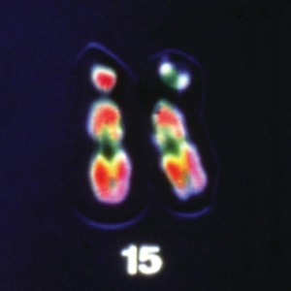
What are Alleles?
Alleles are found directly on chromosomes.
Alleles are different forms (types) of the same gene (trait)
Ex. Gene for height= H/h
You have Two alleles for each trait
1 from your mother and 1 from your father
3 different allele combinations can be possible:
HH / hh / Hh

Slide 10
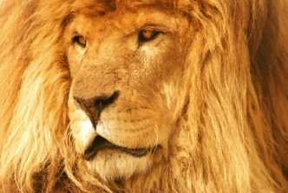
Examples of Alleles
Dominant
Trait that shows up and will hide the recessive allele
Examples: HH & Hh = Tall
Recessive
Trait that can be hidden by the dominant allele
Must have two recessive allele to show recessive trait
Examples: hh = short
Phenotype- What the organism looks like
Genotype- The allele combination an organism contains. [HH or Hh or hh]

Slide 11
Combinations of Alleles
Homozygous Dominant
Having 2 dominant alleles
Example: HH
Heterozygous
Having 1 dominant allele and 1 recessive allele
Example: Hh
Homozygous Recessive
Having 2 recessive alleles
Example: hh

Slide 12
Monohybrid Punnett Square
Monohybrid Punnet Square Set Up:
Both parents are heterozygous for being tall
Monohybrid cross is Hh x Hh
Genotype: HH = 1/4 or 25%, Hh = 2/4 or 50% & hh = 1/4 or 25%
Phenotype: Tall = 3/4 or 75% and short 1/4 or 25%
Possible Alleles individual Sperm cells have from Father
 | H | h
H | HH | Hh
h | Hh | hh
Possible offspring and the Alleles each offspring could receive.
Possible Alleles individual Egg cells have from Mother

Slide 13
Dihybrid Cross
Dihybrid Crosses = (Creates more varied hybrids)
2 traits that differ between parents
Example Traits: Height and shape
Each trait gets one letter =
Height = H is tall & h is short
Shape =R is round & r is wrinkled
One parent is heterozygous tall and heterozygous round (Hh and Rr)
One parent is homozygous short and homozygous wrinkled (hh and rr)

Slide 14
Dihybrid Punnett Square
Dihybrid Punnet Square Set Up:
One parent is heterozygous tall & heterozygous round = HhRr
One parent is homozygous short & homozygous wrinkled = hhrr
The cross is – HhRr x hhrr
NOTICE: I Put all possible combinations the father and mother could provide to the offspring, and each top box gets one of each trait!
 | HR | Hr | hR | hr
hr |  |  |  | hhrr
hr |  | Hhrr
hr |  |  | hhRr
hr | HhRr

Slide 15
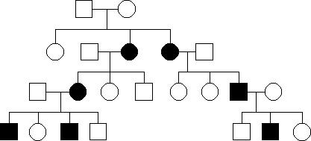
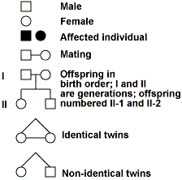
Pedigree
A graphic representation of genetic inheritance
Different symbols represent different traits and organisms

Slide 16
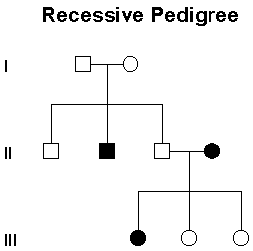
Recessive Pedigree
Simple Recessive heredity
Examples: Cystic fibrosis and Tay- Sachs
Recessive allele must be inherited from BOTH parents for trait to show
Determine Genotypes and Phenotypes for Generation I, II and III

Slide 17
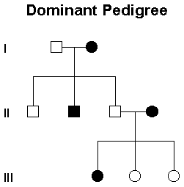
Dominant Pedigree
Simple Dominant heredity
One single dominant allele can be inherited from one parent to show dominant trait
Example: Widows peak and Huntington's disease
Determine Genotypes and Phenotypes for Generation I, II and III

Slide 18
Codominance
Codominance is when both alleles are expressed equally to create a NEW phenotype
Example: Flower color and Blood type
Red flower C^{R} C^{R} crossed with a White flower C^{W} C^{W}
Determine the Genotype and Phenotype for the offspring below
 | C^{R} | C^{R}
C^{W}
C^{W}

Slide 19
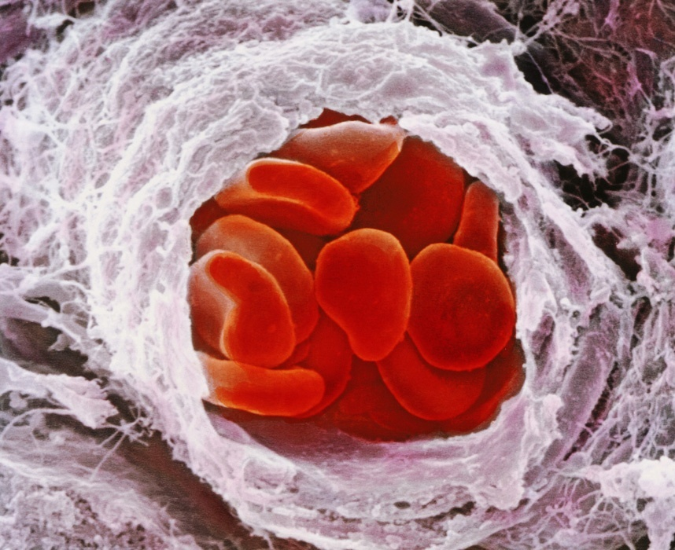
Multiple Alleles
Blood Types are Multiple alleles & Codominance example
Blood type is determined by three different alleles I^{A}, I^{B}, and i.
These three alleles give rise to the ABO blood types in humans
Both A and B result in the creation of specific proteins that appear on the surface of the Red Blood Cell (RBC)
These proteins on the RBC are ID passes to let the body know that these blood cells belong to that body
i is an allele that does not produce proteins on the surface of the RBC.

Slide 20
Blood Types and RBC’s

Slide 21
Blood Type Alleles
Type A Blood alleles:
I^{A} I^{A} OR I^{A} i
Type B Blood alleles:
I^{B} I^{B} OR I^{B} i
Type AB Blood alleles:
I^{A} I^{B}
Type O Blood alleles:
i i

Slide 22
Blood Type Monohybrid Cross
Example: The Father has type A blood and the mother has type B blood. What are the potential blood types of the children
Father is heterozygous for
Type A blood = I^{A} i
Mother is heterozygous
For Type B blood = I^{B} i
The cross is =
I^{A} i x I^{B} I
 | I^{A} | i
I^{B}
i
Determine the Genotype of the offspring:
Determine the Phenotype of the offspring:

Slide 23
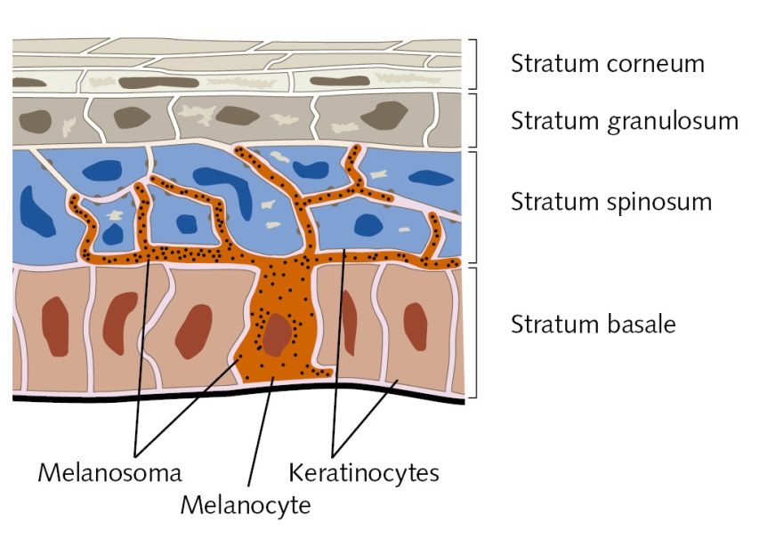
Polygenic Inheritance
Involves two or more genes influencing the expression of one trait.
Example: Skin color –is determined by alleles at several different genes (this gene creates a protein called melanin)
We have packets of melanin in our skin that is the color brown.
Some of us have more melanin or less.
The more melanin you have, the darker skin you have.

Slide 24
Types of Chromosomes
Autosomes – contain genes not associated with sex
In humans there are 22 pairs of autosomal chromosomes
Sex chromosomes – directly control sexual traits.
In humans there is 1 pair of sex chromosomes
Females have two X chromosomes
Males have one X and one Y chromosome

Slide 25
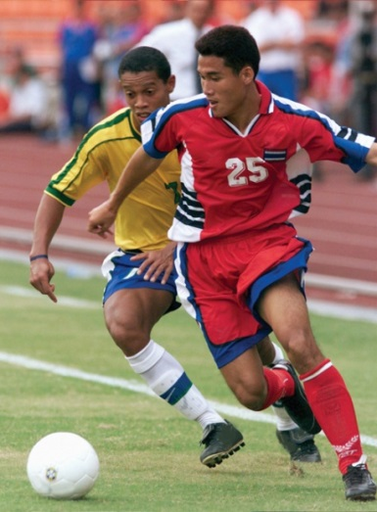
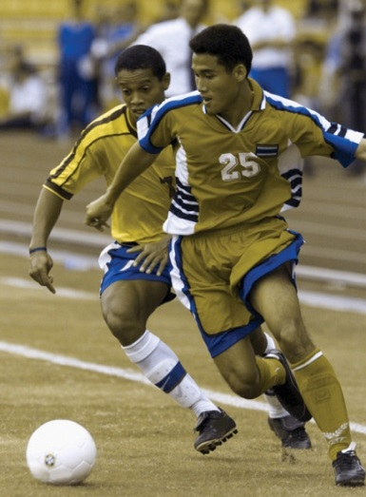
Sex-linked Inheritance
Sex Chromosomes (The 23rd chromosomes) determine sex of offspring
There are certain traits controlled by genes located on sex chromosomes
Sex-linked traits deal with only two chromosomes: X and Y
Females are X X and Males are X Y
Ex: Disorders on the X chromosome
red-green color blindness- recessive allele
Male pattern baldness
Baldness
Red-Green Color Blindness

Slide 26
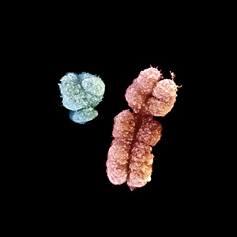
How Sex-Linked Traits are Passed on
If trait is a X-linked trait the mother and father can both pass the trait on
If the trait is a Y-linked trait only the father can pass it on
The trait in question gets written as a superscript:
Example: X-linked recessive trait
Female without the trait = X^{H} X^{H} OR X^{H} X^{h}
Female with the trait = X^{h} X^{h}
Male without the trait = X^{H} Y
Male with the trait =X^{h} Y

Slide 27
Sex-Linked Punnett Square Set Up
Example of a Sex-linked trait is Hemophilia
Hemophilia is a X-linked recessive disease
Example: The father does not have hemophilia but the mother is a carrier of the disease.
Father is X^{H}Y and the Mother is X^{H}X^{h}
The cross is = X^{H}Y x X^{H}X^{h}
Determine the Genotype of the offspring:
Determine the Phenotype of the offspring:

Slide 28
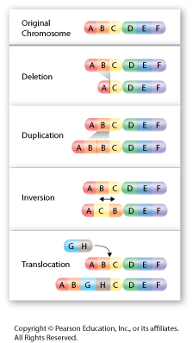
Mutations
Any random change in the DNA base sequence
This could happen due to:
Deletion of bases
Duplicating bases
Point Mutation - Certain bases changing places
New bases being inserted where they do not belong.
Mutations can result in:
Genetic diseases
Cancer
New genetic traits
No harm at all

Slide 29
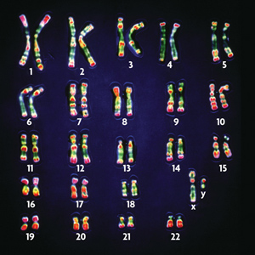
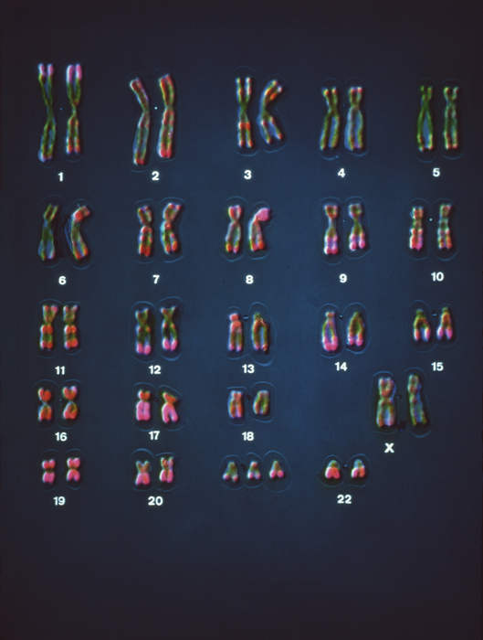
Karyotypes
Karyotype- is the number and appearance of chromosomes in the nucleus of a eukaryotic cell
Karyogram - a diagram or photograph of the chromosomes of a cell, arranged in homologous pairs and in a numbered sequence (chromosomes are arranged in order according to size, shape and centromere position)
Used to check for chromosomal number abnormalities

Slide 30
Genetic Disorders
Disorder | Mutation | Chromosome
Color blindness | Point | X
Cystic fibrosis | Point | 7
Down syndrome | Extra Chromosome 21 | 21
Hemophilia | Point | X
Sickle-cell disease | Point | 11

Slide 31
Gene Transfer
Gene Transfer – A technique of taking a gene out of one organism and placing it in another organism.
This is possible because DNA is universal
The same amino acids are coded for by the same codons on the mRNA.
Example: Placing the gene that codes for insulin in bacteria cells in order to produce insulin for diabetics

Slide 32
Materials Used for Gene Transfer
Plasmids - small circles of DNA in bacteria or prokaryotic cell
Host cell – bacteria or yeast (prokaryotic cell with plasmids)
Restriction enzymes- a protein that finds and recognize a specific sequence of base pairs along the DNA molecule
DNA ligase – connects or glues sequences together

Slide 33
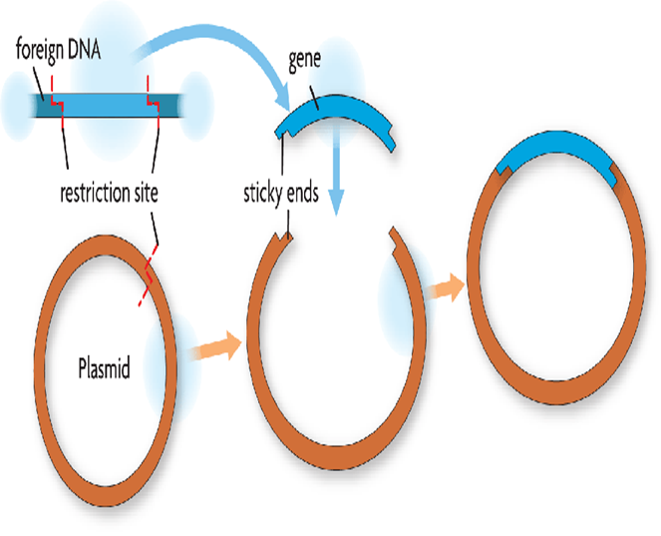
Gene Transfer Process
A gene is selected to be transferred into an organism
Restriction Enzymes are used to cut both the gene of interest from the DNA and the plasmid in the prokaryotic cell
The gene is inserted into plasmid using Ligase
The plasmid with the new gene is inserted into the bacteria (host cell)
This results in the bacteria making many copies of the gene
The Isolated gene is then passed into the genome of the desired organisms using an enzyme

Slide 34
GMO’s
GMO is a Genetically Modified Organism
An organism that has had an artificial genetic change due to gene transfer.
Genes in certain plants may be removed and replaced with genes that are more desirable.
Genetically modified food has helped farmers to grow foods in various otherwise unsuitable conditions
Example: 85% of corn has been modified so that they are resistant to the herbicide glyphosate, which is used to kill weeds

