Slide 1
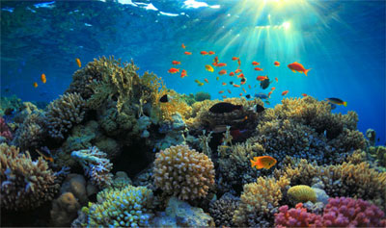
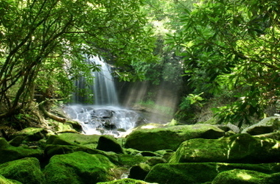
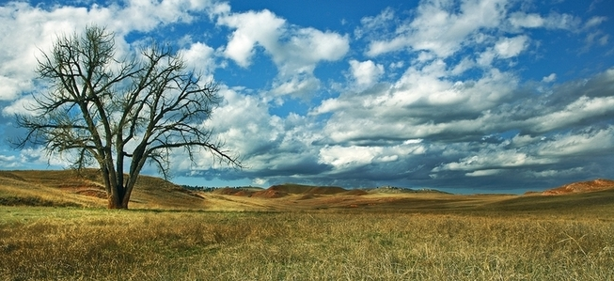
Unit 7 Ecology

Slide 2
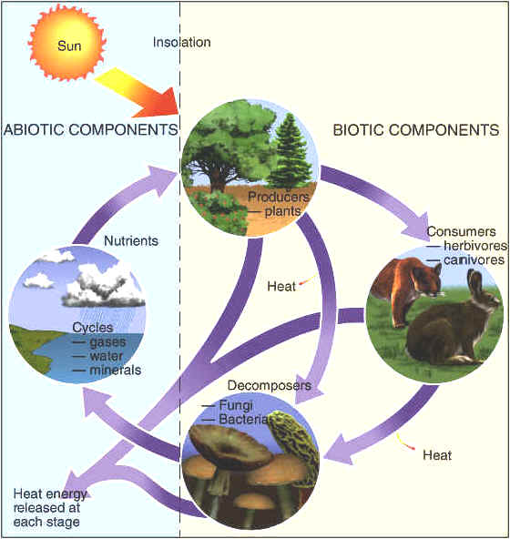
Ecology- the study of interactions between organisms and their environments
The environment is made up of two factors:
Biotic factors- all living/once living organisms inhabiting the Earth
Abiotic factors- nonliving parts of the environment (i.e. temperature, soil, light, moisture, air currents)
Notes:
What do you think about when I say ecology? Recycling? Acid rain?

Slide 3
Biosphere
Ecosystem
Community
Population
Organism
Notes:
Just like with classification, ecology is hierarchal. Each level builds on itself and they fit together like nesting boxes.

Slide 4
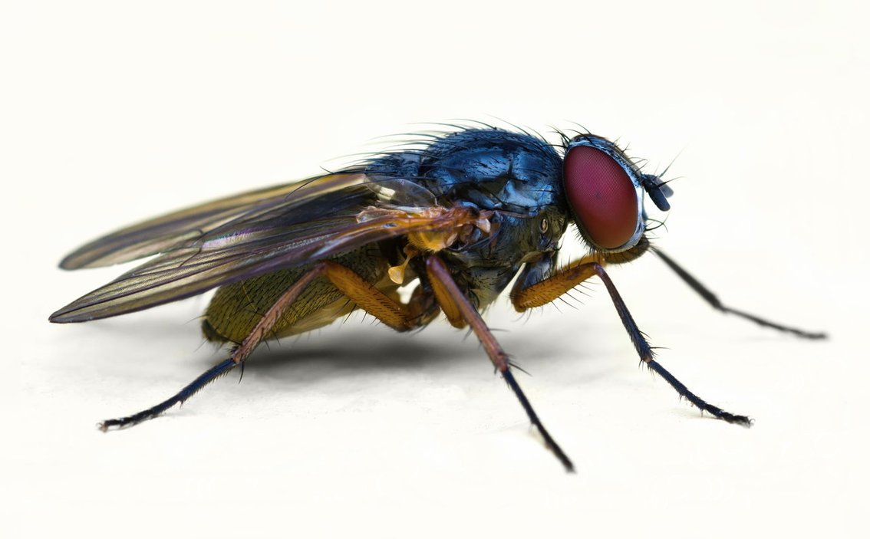
Organism
Anything exhibiting all of the characteristics of life as an individual.
The lowest level of organization in ecology

Slide 5
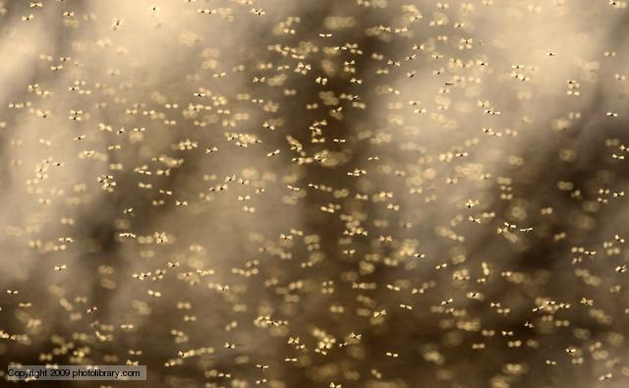
Population
a group of individual organisms of one species living in the same place at the same with the ability to interbreed.

Slide 6
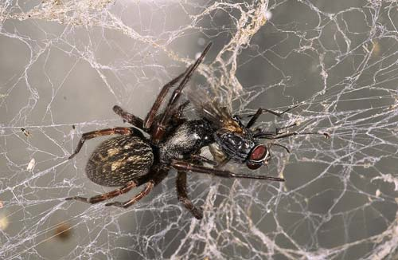
Community
Interacting populations that inhabit a common environment and are interdependent. (All biotic components in an ecosystem)

Slide 7
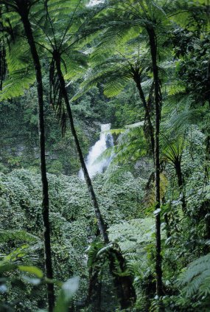
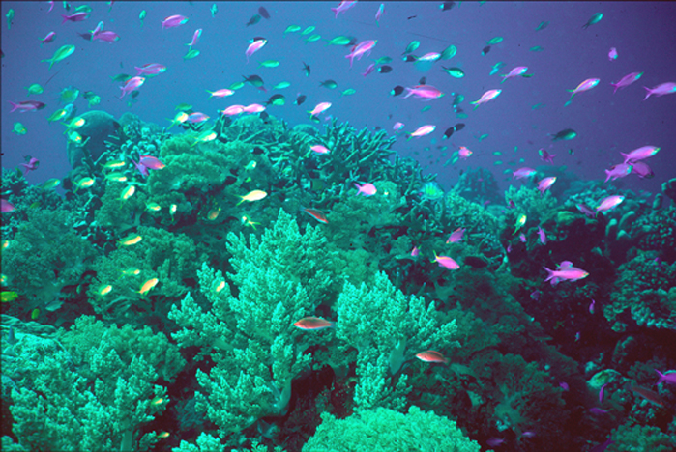
Ecosystem
All the biotic and abiotic components interacting with each other.

Slide 8
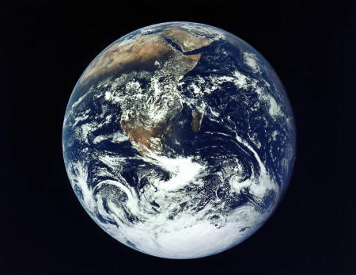
Biosphere
The life supporting portions of Earth composed of air, land, fresh water, and salt water.
The highest level of organization
The Biosphere is composed of many Biomes
Notes:
Lets review. Organisms make up populations, populations make up communities, communities and abiotic factors make up ecosystems, and all of the ecosystems make up the biosphere. From one to many and each depending on the other.

Slide 9
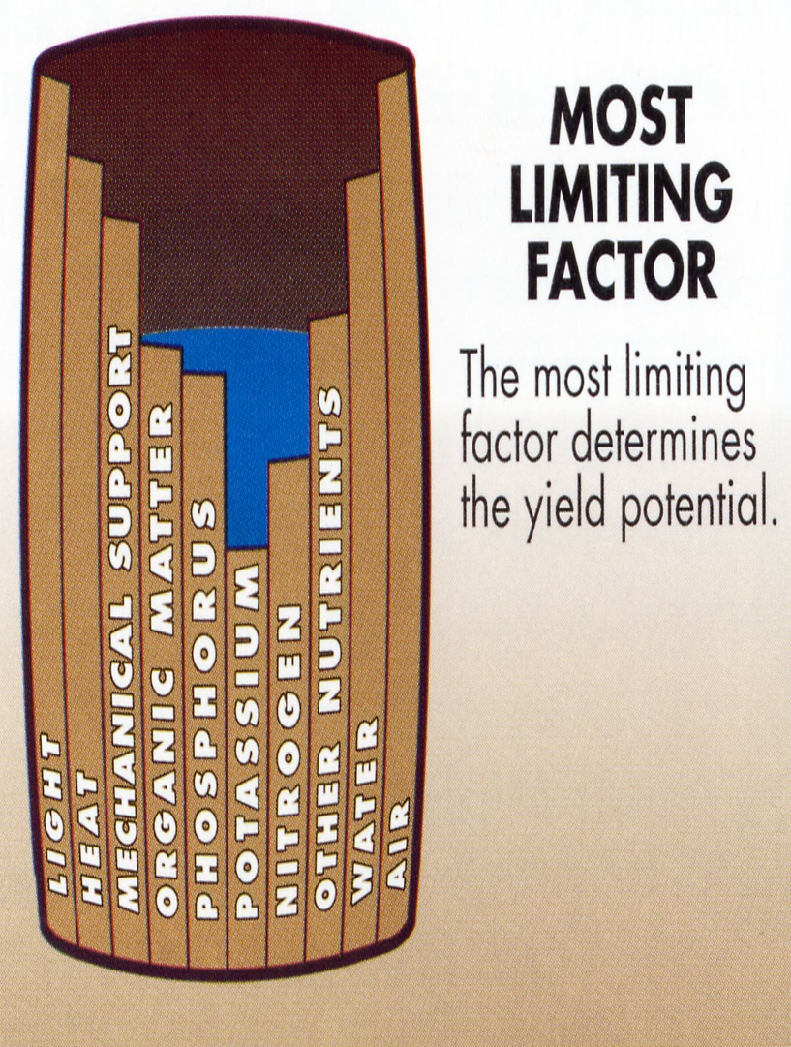
Habitat vs. Niche
Habitat- the place in which an organism lives out its life
Niche - the role a species plays in a community (job)
A niche is determined by a limiting factor.
Limiting factor- any biotic or abiotic factor that restricts the existence of organisms in a specific environment.
Examples of limiting factors
Amount of water, food, Temperature
Notes:
Although several species may share a habitat they each have their own niche. A niche is a very narrow range where a species fits within a habitat.

Slide 10
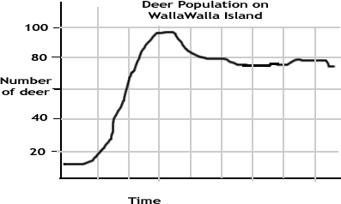
Carrying Capacity
the maximum population size that can be supported by the available resources
There can only be as many organisms as the environmental resources can support
S-shaped curve (logistic growth)
N
u
m
b
e
r
Carrying Capacity (k)
J-shaped curve (exponential growth)
Time
Notes:
Although several species may share a habitat they each have their own niche. A niche is a very narrow range where a species fits within a habitat.

Slide 11
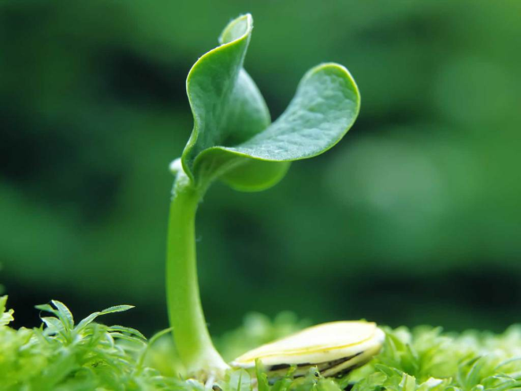
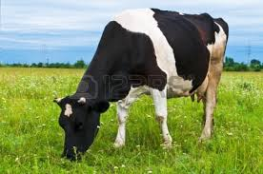
Feeding Relationships
There are 4 main types of organisms in ecosystems
Producer- all autotrophs (plants), they trap energy from the sun to make food (sugar).
Bottom of the food chain
Consumers- all heterotrophs: they ingest food containing the sun’s energy
Notes:
How do they trap the sun’s energy? Through what process? What is that process similar to in animal cells?

Slide 12
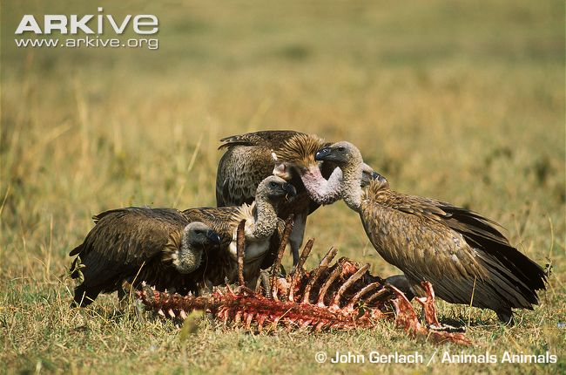
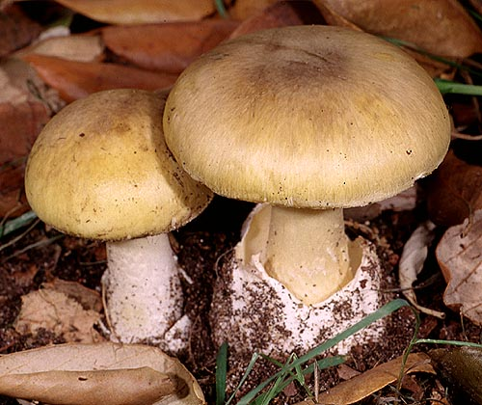
Scavengers/Detritivores
Feed on dead animals and plants but do not return nutrients back into the soil
Decomposers
Decomposers breakdown the complex compounds of dead and decaying plants and animals and return nutrients back into the soil (Bacteria & Fungi)
Notes:
Scavengers are a type of carnivore that eat dead animals, or carrion. Vultures, hyenas, crabs, deep sea fish-talk about distance from the sun and must eat the dead things that sink to the bottom, bottom feeders

Slide 13
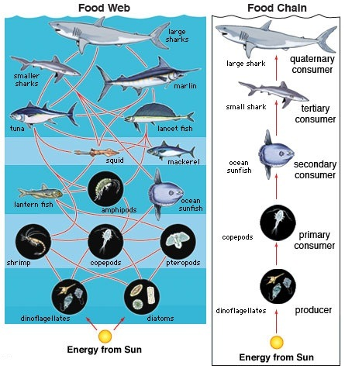
Food Chain
Shows the flow of energy from one trophic level to the next
Food Web
shows all possible feeding relationships in a community at each trophic level
Represents a network of interconnected food chains

Slide 14
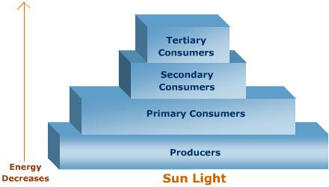
Trophic Levels
Each link in a food chain is known as a trophic level.
Trophic levels represent a feeding step in the transfer of energy and matter in an ecosystem.
Carnivores
Heterotrophs
Carnivores/
Omnivores
Herbivores
Autotrophs

Slide 15
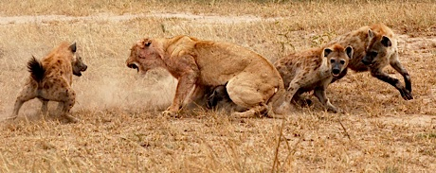
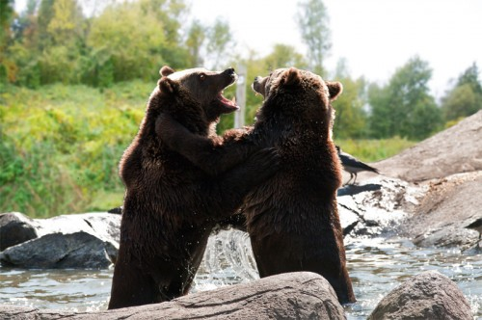
Population interactions
Competition – Occurs when resources are limited and organisms seek to utilize this common resource
Interspecific – Competition between two different species
Intraspecific- Competition within the same species
Notes:
Cleaning shrimp

Slide 16
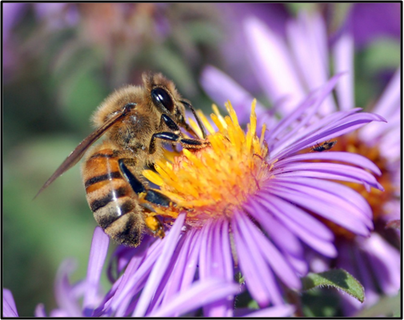
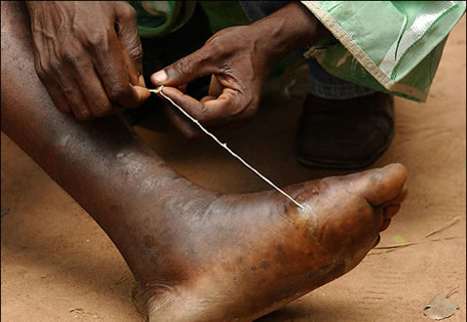
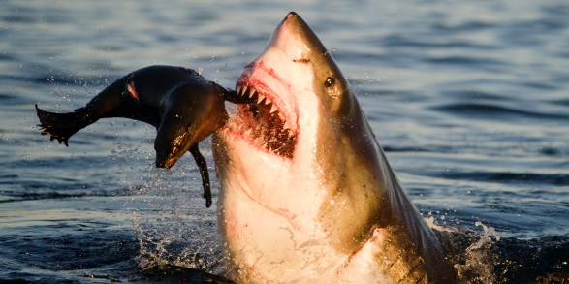
Population interactions
Mutualism – Symbiotic relationship where two organisms live together and both benefit.
Parasitism- Relationship where one organism benefits at the expense of the other (lives on or in another organism)
Predation- One organism hunts and eats another organism

Slide 17
Nutrient Cycles
Cycling maintains homeostasis (balance) in the environment.
3 cycles to investigate:
Water cycle
Carbon cycle
Nitrogen cycle

Slide 18
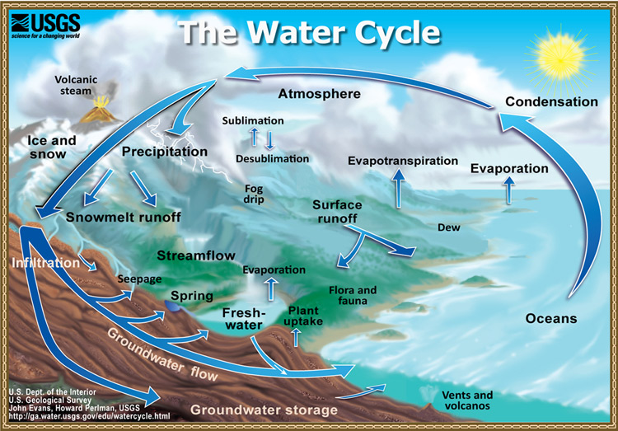
Water cycle – Driven by sunlight energy.
Important processes include…
Evaporation
Transpiration
Condensation
Precipitation

Slide 19
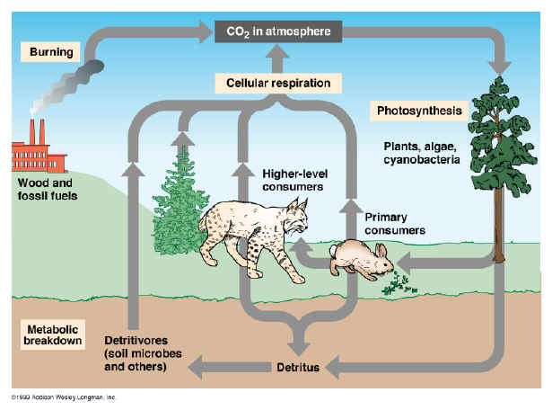
Carbon cycle -
Photosynthesis and respiration cycle carbon and oxygen through the environment.

Slide 20
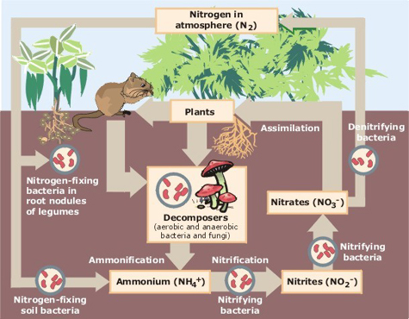
Nitrogen cycle -
Atmospheric nitrogen (N₂) makes up nearly 80% of air.
Organisms can not use it in that form.
Lightning and bacteria convert nitrogen into usable forms.
Nitrogen fixation-convert atmospheric nitrogen (N₂) into ammonium (NH₄⁺) which can be used

Slide 21
Land Biomes
Biome- geographic areas that have similar climates and ecosystems
The 6 most common biomes are:
Tundra
Taiga
Temperate Deciduous Forest
Tropical Rain Forest
Grassland
Desert

